Slide 1
Statistical Exploration on Liver Disease Data
Melvin Joshua

Slide 2
Research Abstract
This study explores the distribution of liver disease diagnosis across various features and evaluates the predictive power of categorical features using Information Value (IV) and Weight of Evidence (WoE). The dataset is obtained from Kaggle, which has 1700 records. Key findings reveal that patients with high BMI or those who are middle-aged are likelier to develop liver disease. The purpose of this research is to uncover critical insights that facilitate early detection, risk assessment, and informed decision-making in healthcare. The tool used is the programming language, Python, for performing Exploratory Data Analysis (EDA).

Slide 3
Research Problem
Liver disease, often diagnosed at advanced stages, lacks effective tools for early detection. Current research inadequately explores the role of key risk factors (e.g., BMI, age, lifestyle) in predicting liver disease. This study aims to identify and analyze these critical factors to enable early risk assessment and improve healthcare outcomes.

Slide 4
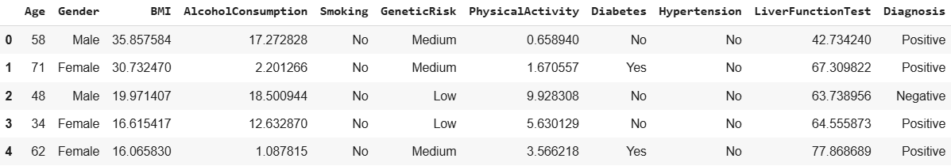
Data Description
This dataset has 1700 rows and 11 columns.
There is neither a missing record nor a duplicated record.
55% of patients are diagnosed as positive, and 45% as negative.

Slide 5
Attribute Information
Attribute | Range/Categories | Description
Age | 20 to 80 years | Age of the patient.
Gender | Male, Female | Gender of the patient.
BMI | 15 to 40 | Body Mass Index.
Alcohol Consumption | 0 to 20 units/week | Weekly alcohol intake.
Smoking | Yes, No | Smoking habit.
Genetic Risk | Low, Medium, High | Genetic predisposition to liver disease.
Physical Activity | 0 to 10 hours/week | Weekly physical activity.
Diabetes | Yes, No | Presence of diabetes.
Hypertension | Yes, No | Presence of high blood pressure.
Liver Function Test | 20 to 100 | Liver health score.
Diagnosis | Positive, Negative | Presence of liver disease.

Slide 6
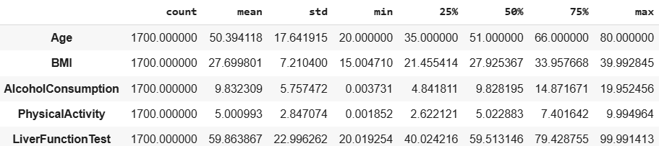
Descriptive Statistics

Slide 7
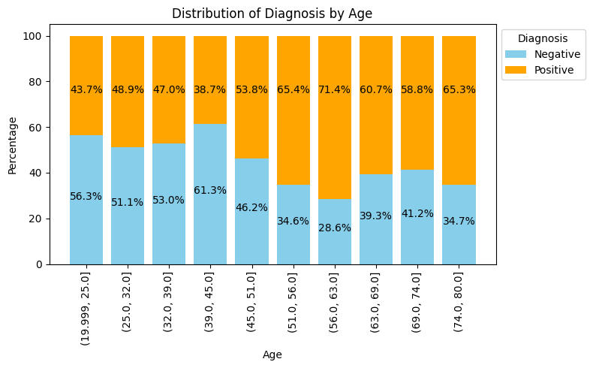
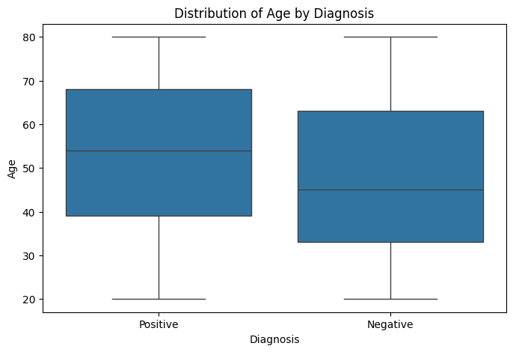
Age Vs Diagnosis
Liver disease tends to become more prevalent in middle-aged and older individuals.
The lowest rates of positive diagnoses are observed in the youngest age group, whereas the highest rates are observed in individuals aged 51.0 – 63.0. The higher median age and the concentration of cases in the 50–70 age range suggest that age is a significant risk factor.

Slide 8
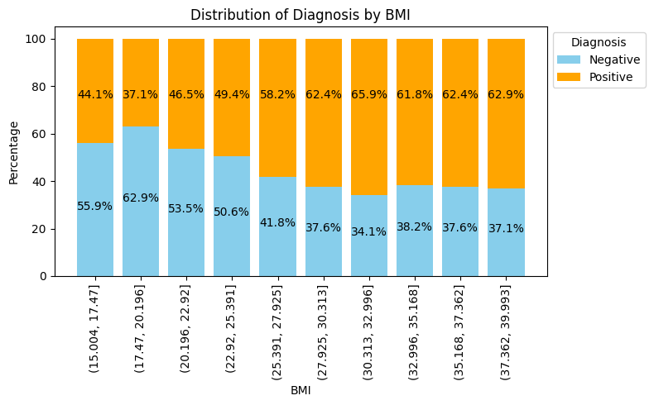
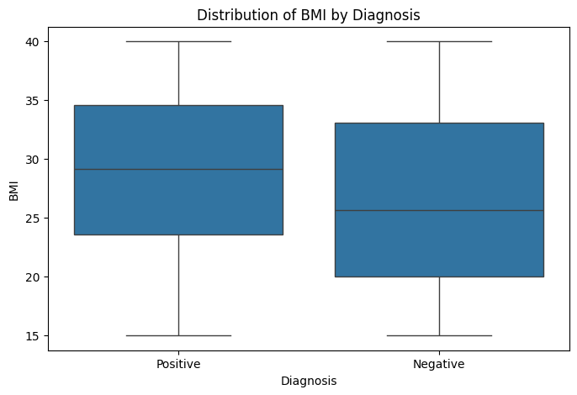
BMI Vs Diagnosis
Liver disease prevalence increases with BMI, peaking in the overweight range (25.391 – 27.925) at 58.2% positive diagnoses. Beyond this, the proportion of positive diagnoses stabilizes around 62% – 65% in the overweight and obese categories. Lower BMI ranges have fewer positive cases, making BMI a strong predictor of liver disease risk.

Slide 9
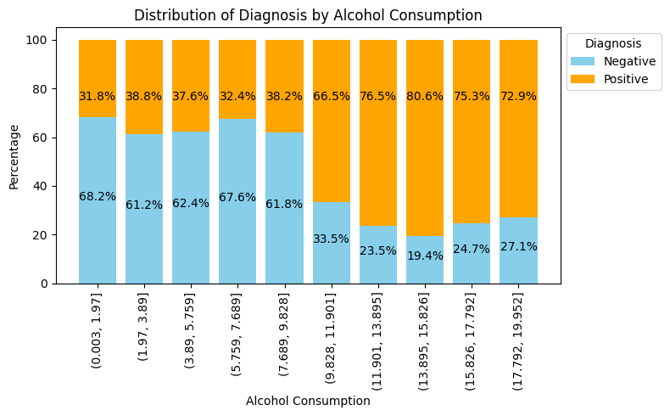
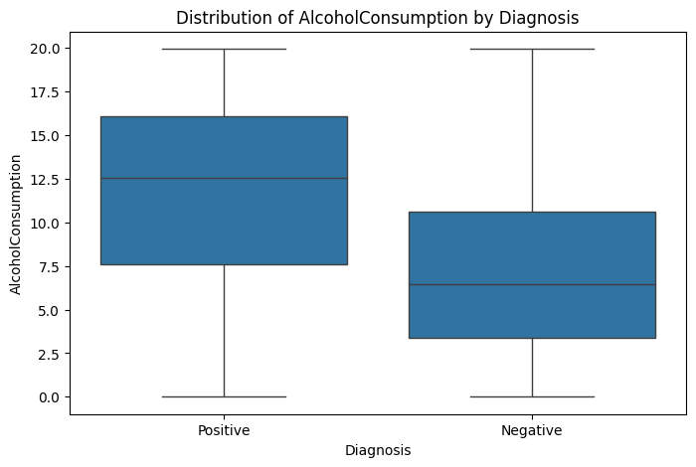
Alcohol Consumption Vs Diagnosis
Higher alcohol consumption strongly correlates with liver disease diagnosis. Those with positive diagnoses had nearly double the median alcohol consumption (approx. 12.5) compared to negative cases (approx. 6.5).
A clear threshold effect appears around 9-11 consumption units, above which positive diagnoses become dominant (>65%). At the highest consumption levels (15+), about 75% of cases are positive for liver disease.

Slide 10
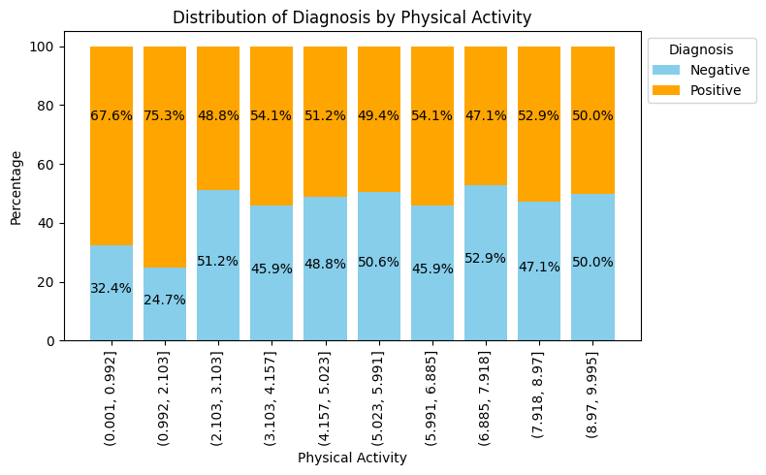
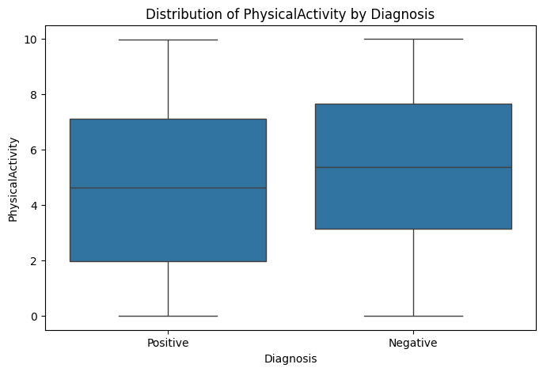
Physical Activity Vs Diagnosis
Physical Activity shows a weaker relationship with liver disease diagnosis. The box plot shows only slightly higher physical activity levels in negative cases (median approx. 5.5) versus positive cases (median approx. ~4.5). The stacked bar chart reveals no clear trend, with diagnosis ratios remaining relatively consistent across different physical activity levels, though there's a slight indication that very low activity (0-2) may be associated with higher positive diagnoses.

Slide 11
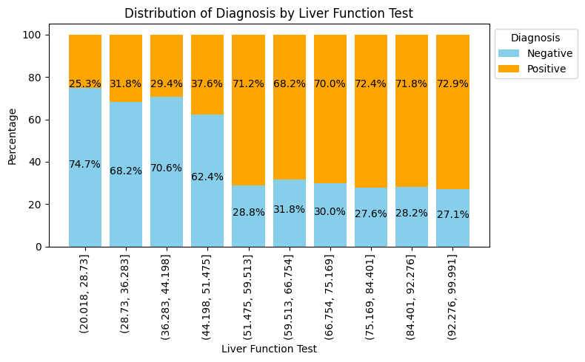
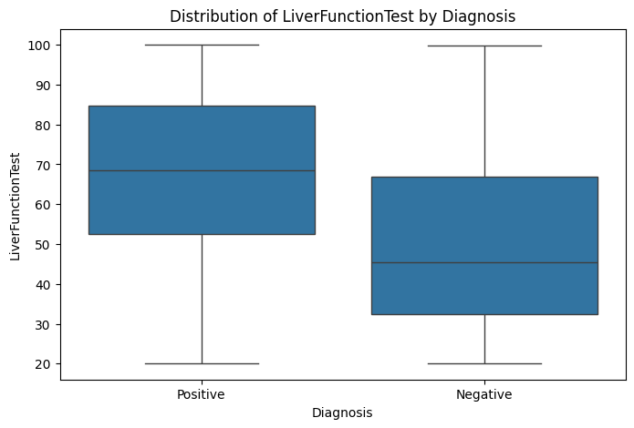
Liver Function Test Vs Diagnosis
The liver function test shows a strong correlation with diagnosis outcomes. In the box plot, positive cases have notably higher test values (median approx. 70) compared to negative cases (median approx. 4). The stacked bar chart demonstrates a clear progression: as liver function test values increase beyond approx. 50, the proportion of positive diagnoses dramatically rises from around 30% to over 70%. This suggests that liver function test values are a strong predictor of liver disease diagnosis.

Slide 12
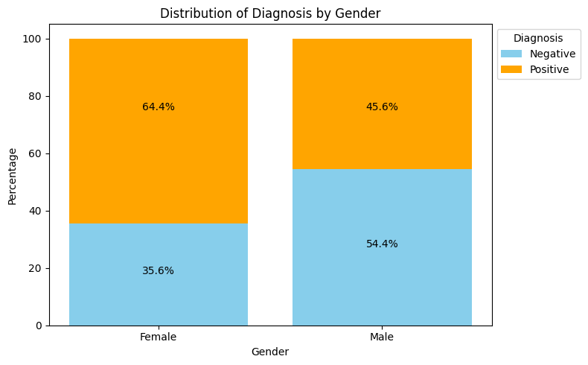
Gender Vs Diagnosis
The data shows a gender disparity in liver disease diagnosis. Women have a higher positive diagnosis rate (64.4%) compared to men (45.6%). Men show more negative cases (54.4%) than women (35.6%).

Slide 13
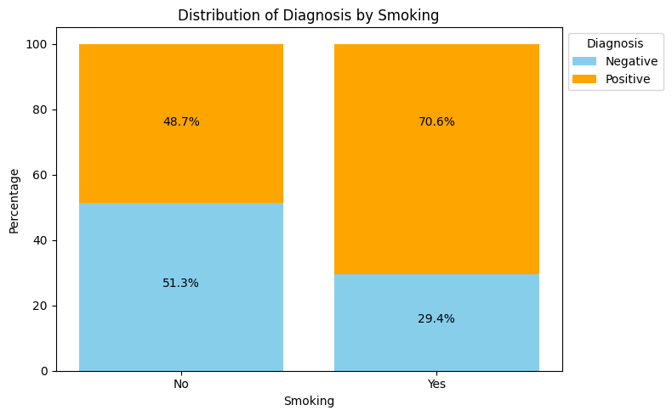
Smoking Vs Diagnosis
Smokers show significantly higher liver disease rates (70.6% positive) compared to non-smokers (48.7% positive). Non-smokers have a more balanced distribution with slightly more negative cases (51.3%) than positive.

Slide 14
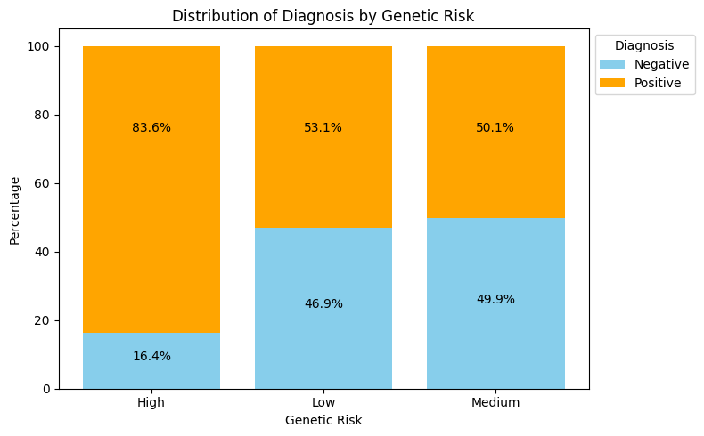
Genetic Risk Vs Diagnosis
Genetic risk is a significant factor in the likelihood of a positive diagnosis. Higher genetic risk correlates strongly with a higher percentage of positive diagnoses. Individuals with low genetic risk are much more likely to have a negative diagnosis.

Slide 15
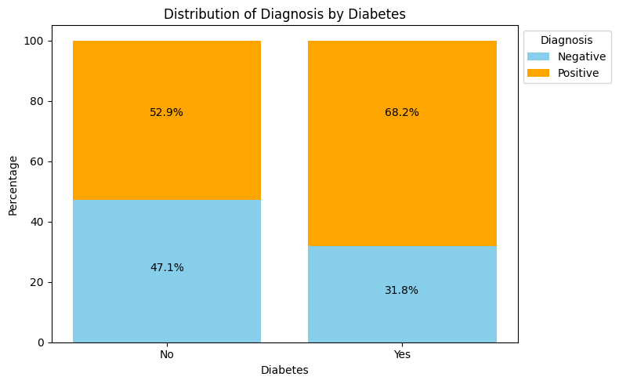
Diabetes Vs Diagnosis
There is a 15.3% increase in positive diagnoses among individuals with diabetes (68.2%) compared to those without diabetes (52.9%). This indicates that diabetes significantly elevates the risk of a positive diagnosis for liver disease.

Slide 16

Hypertension Vs Diagnosis
The percentage of positive diagnoses increases significantly (from 51.4% to 74.9%) when hypertension is present. Individuals without hypertension have a nearly balanced distribution between positive and negative diagnoses, with a slight majority (51.4%) having a positive diagnosis.

Slide 17
Hypothesis Testing
For numeric features, performed the Independent t-test for 2 Samples. H0: Means are the same. H1: Means are different.
For categorical features, performed the Chi-Square test. H0: Variables are independent. H1: Variables are dependent.
Result: All the testing proved to be significant, thereby rejecting the null hypotheses.

Slide 18
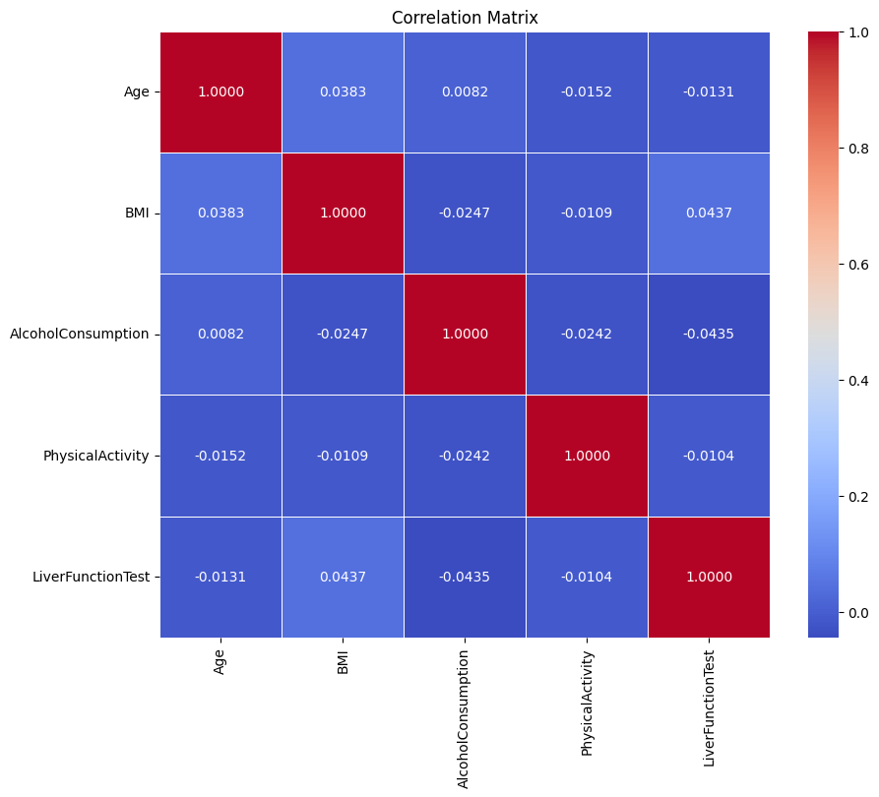
Correlation Analysis
This correlation matrix reveals that the variables in the liver disease dataset have minimal correlation with one another.
The correlation values are close to 0, indicating weak linear relationships. No strong multicollinearity is observed, meaning the variables are likely independent.
LiverFunctionTest shows a weak positive correlation with BMI (0.0437) and weak negative correlations with other variables. Age, AlcoholConsumption, and PhysicalActivity show negligible correlations with one another or with LiverFunctionTest.
This suggests the dataset variables may contribute independently to liver disease prediction.

Slide 19
Weight of Evidence (WoE)
Weight of Evidence (WoE) quantifies the predictive strength of an independent variable concerning the target variable.
It can treat outliers.
It can handle missing values as missing values can be binned separately.
Since WoE transformation handles categorical variable, there is no need for dummy variables.
WoE transformation helps you to build strict linear relationship with log odds. Otherwise, it is not easy to accomplish linear relationship using other transformation methods such as log, square-root, etc.

Slide 20
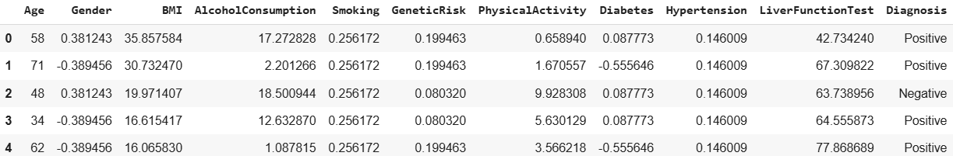
Weight of Evidence (woE)
Dataset after replacing the Categories with their corresponding WoE values, which capture the same behaviour, ensuring no loss of data.

Slide 21
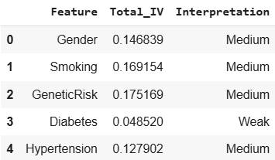
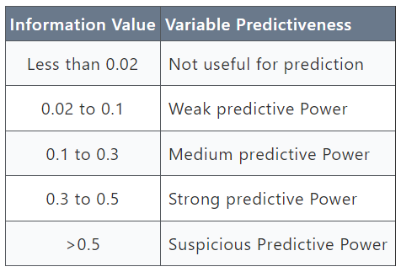
Information Value (IV)
It is one of the most useful techniques to select important variables in a predictive model. It helps rank variables on the basis of their importance.

Slide 22

Methodology
% of Non-Events in a Group is the percentage of non-event outcomes within a specific group relative to the total number of non-event outcomes in the entire dataset.
% of Events in a Group is the percentage of event outcomes within the same group relative to the total number of event outcomes in the entire dataset.
Positive WoE means % of Non-Events > % of Events
Negative WoE means % of Non-Events < % of Events

Slide 23
MeThodOlogy
Steps to calculate WoE:
1. For a continuous variable, split data into 10 parts (or lesser depending on the distribution).
2. Calculate the number of events and non-events in each group (bin)
3. Calculate the % of events and % of non-events in each group.
4. Calculate WoE by taking natural log of division of % of non-events and % of events.
Note: For a categorical variable, you do not need to split the data. (Ignore Step 1 and follow the remaining steps)

Slide 24
METHODOLOGY
Rules related to WoE:
1. Each category (bin) should have at least 5% of the observations.
2. Each category (bin) should be non-zero for both non-events and events.
3. The WoE should be distinct for each category. Similar groups should be aggregated.
4. The WoE should be monotonic, i.e., either growing or decreasing with the groupings.
5. Missing values are binned separately.
In general, 10 or 20 bins are taken. Ideally, each bin should contain at least 5% cases. Fewer bins capture important patterns in the data, while leaving out noise.

Slide 25

Methodology
Handle Zero Event/ Non-Event:
If a particular bin contains no event or non-event, you can use the formula below to ignore missing WOE. We are adding 0.5 to the number of events and non-events in a group.
The IV is calculated using the following formula:
Information value increases as bins / groups increases for an independent variable. As it is specifically designed for Binary Logistic Regression, it is not an optimal feature for other classification models.

Slide 26
Referential Links
Statistical Machine Learning Approaches to Liver Disease Prediction
Liver Disease Prediction using Machine Learning Classification Techniques
Performance Analysis of Liver Disease Prediction Using Machine Learning Algorithms
Liver Disease Prediction using Machine Learning
Intelligent Model to Predict Early Liver Disease using Machine Learning Technique

